Slide 1

SSAEPL
AUV Product Portfolio
Manufactured by Subsea Sales and Engineering Pte Ltd

Slide 2

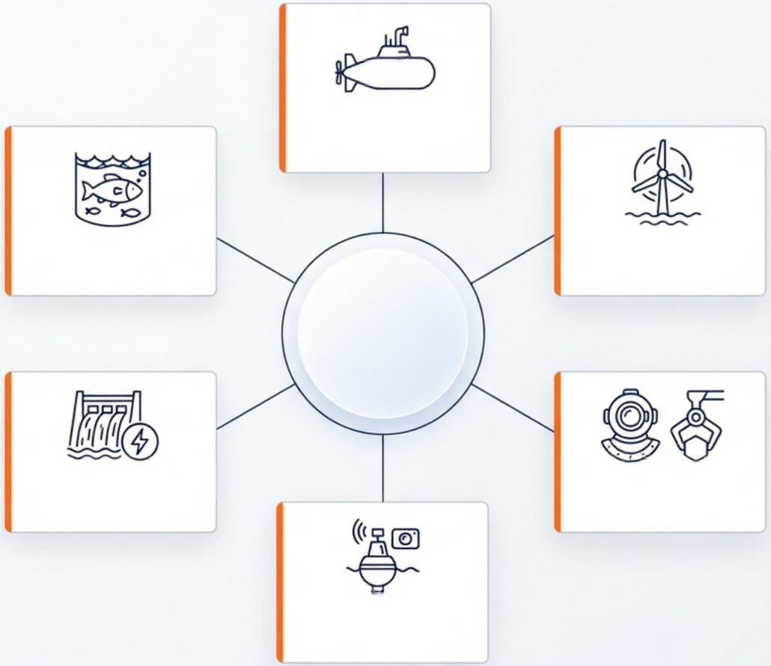

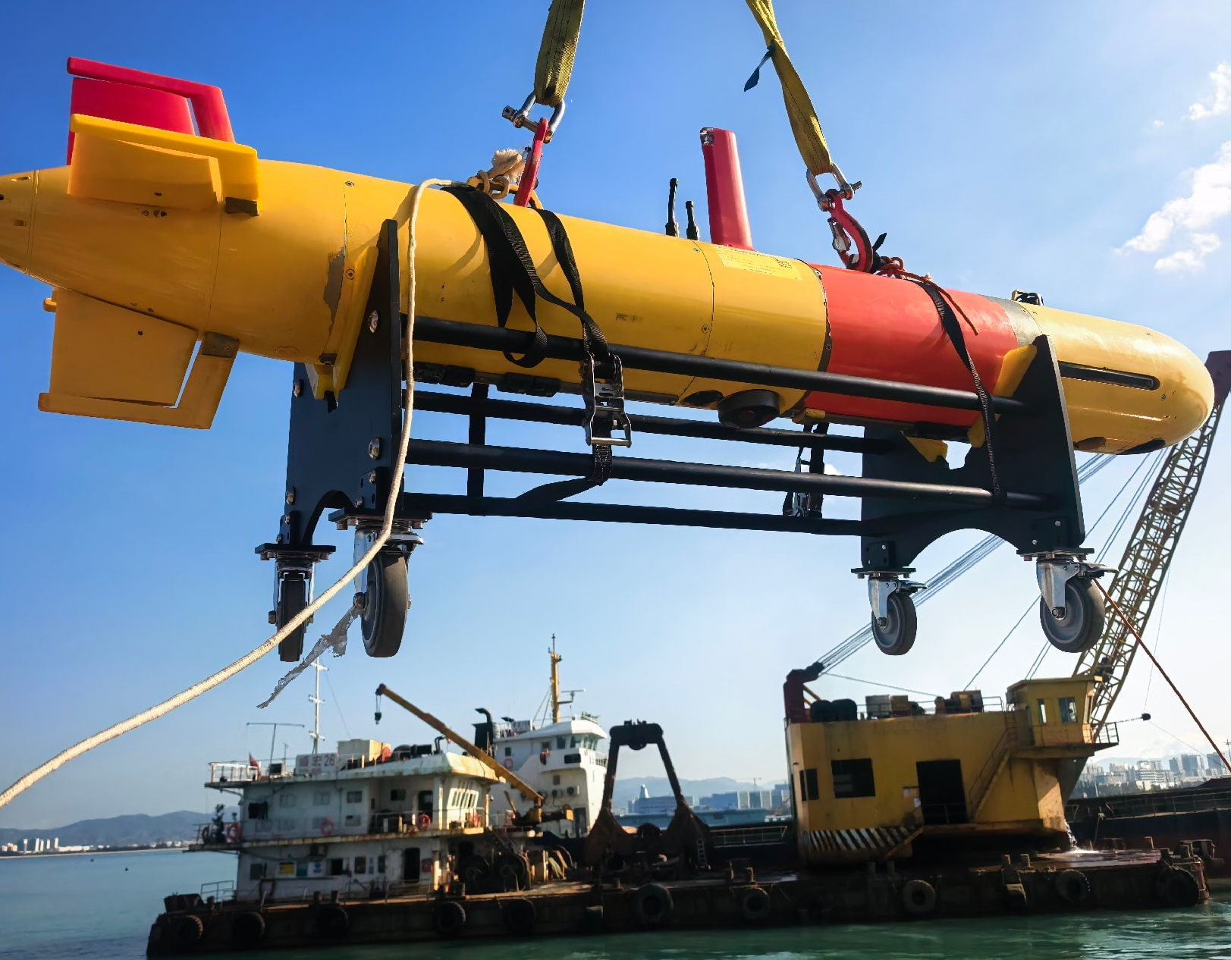
Mission-Ready
Six Domains
000
Scientific
Research
SSAEPL delivers autonomous solutions
for subsea survey, marine engineering,
environmental monitoring, security
and offshore operations.
Aquaculture
Offshore
Wind Power
Water Conservancy
Rescue &
& Hydropower
Salvage
Environmental
Monitoring

Slide 3
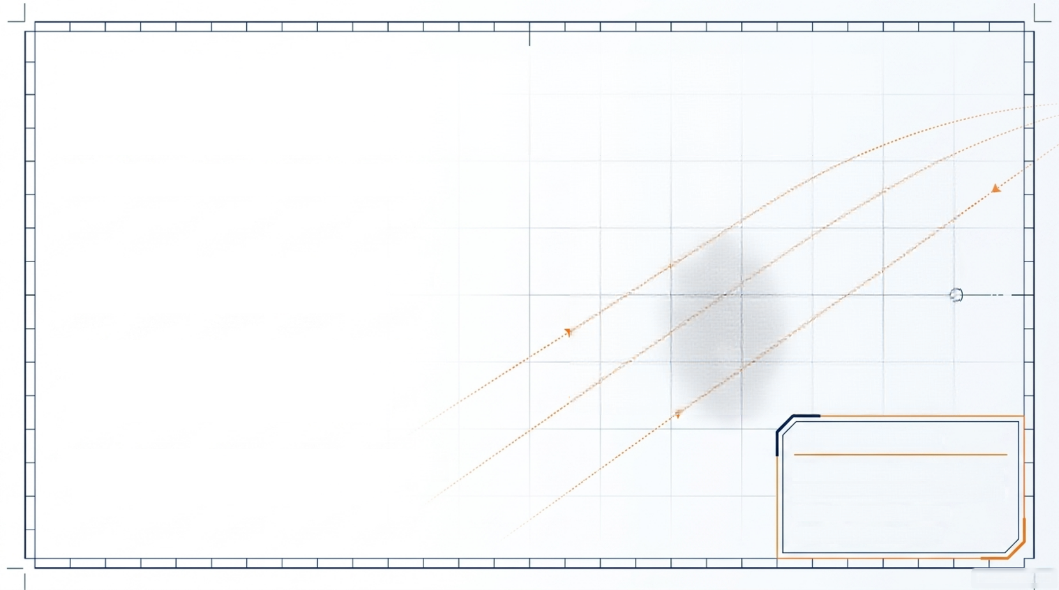
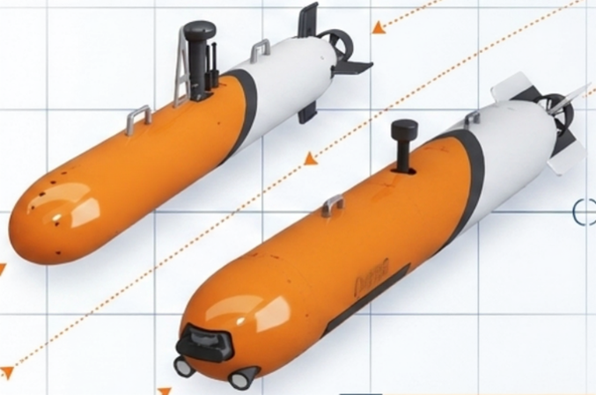
AUV-260: Agile Nearshore
Survey Platform
Small AUV-260
Efficient propulsion; custom speed
up to 15 knots.
SLAM-ready onboard recognition
supports autonomous and
swarm operations.
Core Specifications
20 kg modular payload for sonar,
CTD and imaging.
Depth: 500m
Weight: 100kg | Payload: 20kg
Endurance: 12h @ 3kn
Speed: 1-6 knots

Slide 4
AUV-260 | Technical Specifications
Small AUV · standard configuration unless otherwise stated
Physical size | Ø260 mm × 2.5 m
Weight / payload | 100 kg standard · 20 kg payload
Working depth | 0–500 m
Velocity | 1–6 kn standard · custom maximum up to 15 kn
Propulsion | Integrated propeller-motor + cross/X rudder; optional horizontal/vertical thrusters
Endurance | 12 h at 3 kn
Navigation | INS + DVL + GNSS + USBL; better than 0.3% / 0.5% / 1% of range, configurable
Communications | UHF, Wi-Fi, 4G, AIS; optional satellite and underwater acoustic links
AUTONOMY & CONTROL
SLAM-ready online recognition and processing, autonomous trajectory/depth/altitude control, obstacle avoidance and surface/BLOS remote control.
PAYLOAD INTEGRATION
20 kg capacity for underwater CCD, CTD, altimeter, obstacle sonar, side-scan sonar, multibeam sonar, hydrophones and USBL.
SOFTWARE & SUPPORT
Visual HMI supports secondary development, post-mission analysis and maintenance. Ground control station or rugged laptop with portable communications box.
Source: user-provided product brochure
SSAEPL

Slide 5

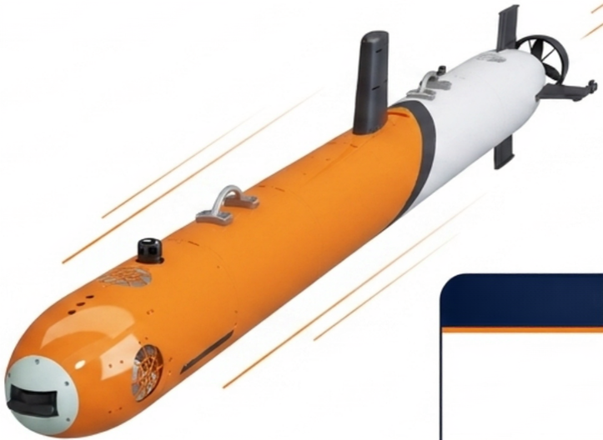
AUV-324: Deep-Diving
Long-Endurance
Medium AUV-324
Deployable from shore, vessel or
submarine platforms.
Modular 30 kg payload bay supports
multi-mission expansion.
Core Specifications
Up to 2,000 m depth with extended
50-hour / 300 km options.
Depth: 600m / 2000m
Weight: 300kg (30kg payload)
Endurance: 20-50h (up to 300km)
Length: 4.0 meters
2000m

Slide 6
AUV-324 | Technical Specifications
Medium AUV · modular deep-water survey platform
Physical size | Ø324 mm × 4.0 m
Weight / payload | 300 kg standard · 30 kg payload
Working depth | 600 m / 2,000 m
Velocity | 1–6 kn
Propulsion | Tail propeller + cross/X rudder; optional vertical auxiliary or vector propulsion
Endurance | ≥20 h at 3 kn; extendable to 50 h at 3 kn or 300 km range
Navigation | INS + DVL + GNSS + USBL; 0.3% / 0.5% / 1% of range, configurable
Communications | UHF, Wi-Fi, 4G, satellite and underwater acoustic communications
DEPLOYMENT & MISSIONS
Deployable from shore, vessel or submarine platforms for reconnaissance, search, minesweeping, engineering survey and scientific exploration.
MODULAR PAYLOAD
Custom user payload bay with CCD, CTD, altimeter, obstacle sonar, side-scan sonar, multibeam sonar and USBL integration.
AUTONOMY & SUPPORT
Trajectory tracking, autonomous depth/altitude control, obstacle avoidance and remote communications. Integrated ground control station and visual HMI.
Source: user-provided product brochure
SSAEPL

Slide 7
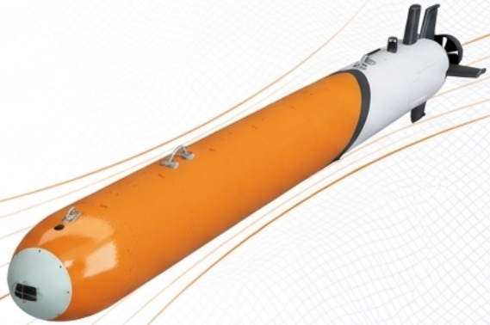
AUV-533: 6,000m
Extreme-Range
Large AUV-533
Full-domain exploration to 6,000 m,
including polar missions.
Modular 150 kg payload bay for
deep-sea survey sensors.
Core Specifications
Up to 180 hours or 1,000 km with
emergency communications.
Depth: 2000m / 6000m
Weight: 1200kg | PL 150kg
Endurance: 90–180h | 1,000km
Length: 5.0 meters
6000m

Slide 8
AUV-533 | Technical Specifications
Large-displacement AUV · deep-ocean and polar operations
Physical size | Ø533 mm × 5.0 m
Weight / payload | 1,200 kg standard · 150 kg payload
Working depth | 2,000 m / 6,000 m
Velocity | 1–6 kn
Propulsion | Tail propeller + cross/X rudder; optional vertical auxiliary propulsion and positioning
Endurance | ≥90 h at 3 kn; extendable to 180 h at 3 kn or 1,000 km range
Navigation | INS + DVL + GNSS + USBL; 0.3% range accuracy with SLAM/data-driven options
Communications | UHF, Wi-Fi, 4G, satellite and underwater acoustic communications
FULL-DOMAIN CAPABILITY
Designed for deep-sea mineral exploration, physical oceanography, marine engineering, ecological survey, military survey and polar missions.
SAFETY & SUSTAINMENT
Full emergency support system with up to 60 days of unpowered self-sustaining communications at sea.
LAUNCH & PAYLOADS
Dedicated automated LARS and integrated deck container for transport, storage, processing and maintenance; modular 150 kg sensor payload bay.
Source: user-provided product brochure
SSAEPL

Slide 9
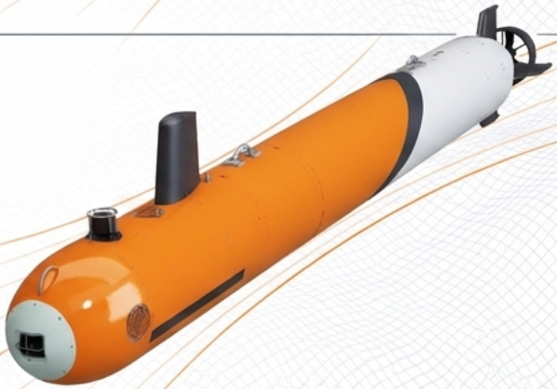
AUV-600: Intelligent Swarm
Survey Platform
Large AUV-600
Swarm control supports formation
keeping, switching and search.
Multi-network communications
auto-switch in weak signals.
Core Specifications
Online seabed recognition enables
collaborative detection.
Depth: 1km / 3km / 6km
Weight: 1200kg
Endurance: 24h @ 3kn
Length: 6.0 meters
6000m

Slide 10
AUV-600 | Technical Specifications
Large AUV · coordinated swarm detection platform
Physical size | Ø600 mm × 6.0 m
Weight | 1,200 kg standard
Working depth | 1,000 m / 3,000 m / 6,000 m
Velocity | 1–6 kn
Propulsion | Tail propeller + cross/X rudder; optional vertical and lateral thrusters
Endurance | 24 h at 3 kn
Navigation | INS + DVL + GNSS + USBL; 0.5% of range, configurable
Communications | UHF, Wi-Fi, 4G and underwater acoustic communications
SWARM INTELLIGENCE
Formation keeping, formation switching and collaborative swarm control with automatic multi-channel and multi-network switching in weak signals.
COOPERATIVE DETECTION
Multiple AUVs coordinate target search and exploration missions; onboard processing automatically recognizes and classifies seabed targets.
MISSION SYSTEMS
Autonomous trajectory/depth/altitude control, obstacle avoidance and remote control. Integrated GCS plus CCD, CTD and sonar payload options.
Source: user-provided product brochure
SSAEPL

Slide 11
Common Mission Architecture
Configurable Systems Across the SSAEPL AUV Range
INTEGRATED NAVIGATION
INS + DVL + GNSS + USBL
Configurable accuracy: 0.3% / 0.5% / 1% of range
Visual HMI supports mission control, secondary development, data analysis, maintenance and networking.
METHODS OF PROPULSION
Tail propeller + cross/X rudders; optional thrusters enable vertical motion and positioning.
CONTROL & SOFTWARE
MISSION & OPERATION MODES
Trajectory tracking · Depth/altitude control · Obstacle avoidance · Surface/BLOS control
COMMUNICATION SUITE
UHF, Wi-Fi, 4G, AIS, satellite and optional underwater acoustic communications
EXPANDABLE PAYLOAD
CCD, CTD, altimeter, obstacle-avoidance sonar, side-scan sonar, multibeam sonar and USBL

Slide 12

SSAEPL
Explore Deeper, Operate Smarter.
Partner with SSAEPL for reliable, mission-ready AUV solutions.
Subsea Sales and Engineering Pte Ltd

