Slide 1
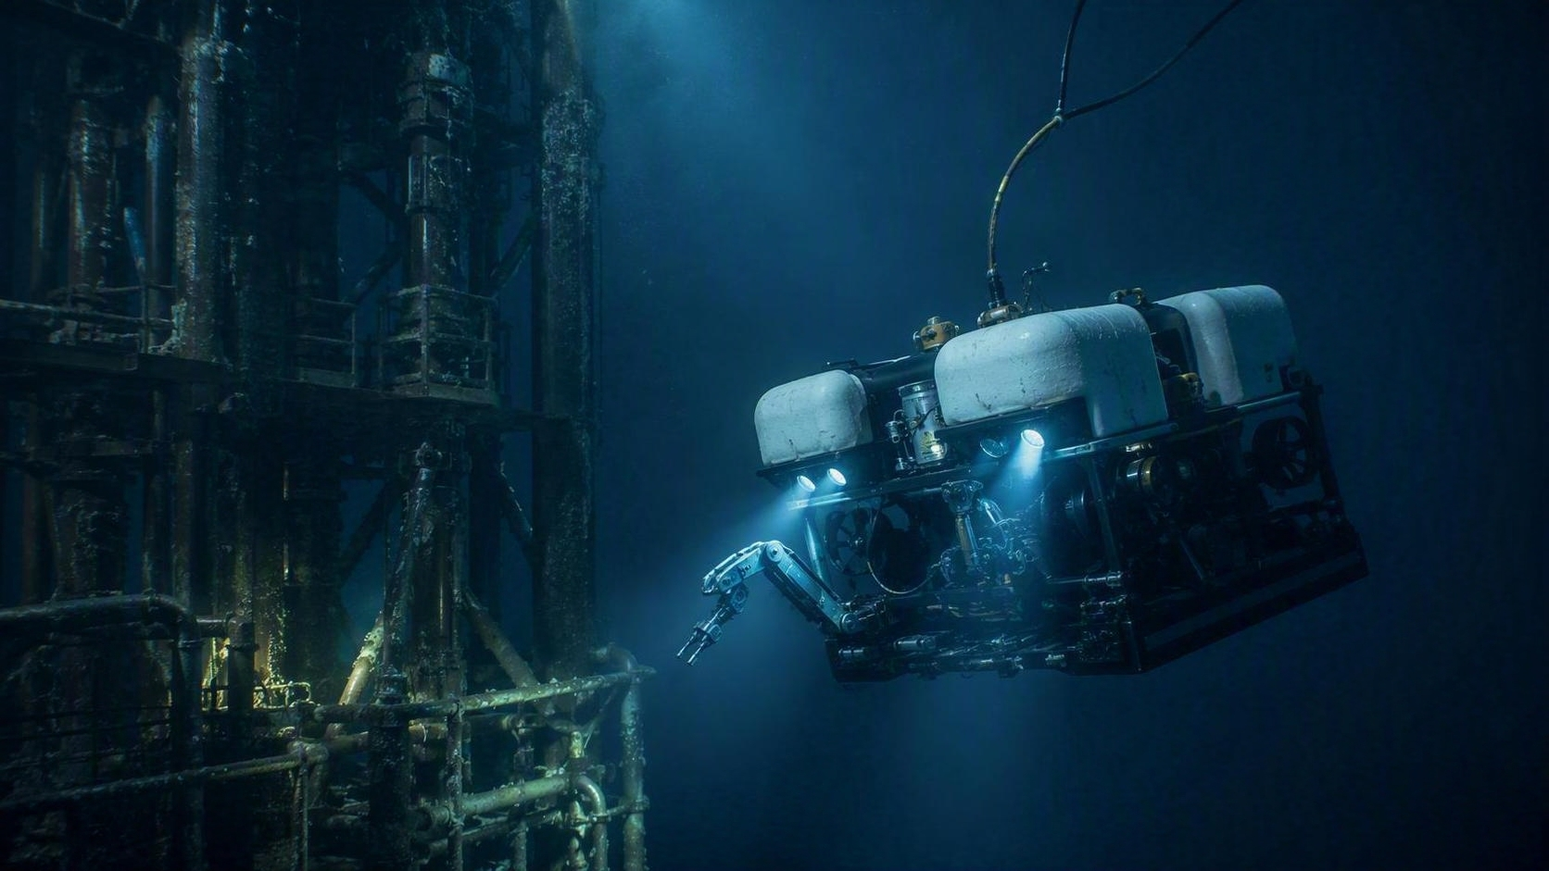
SSAEPL
Subsea buoyancy,
engineered for the mission
Syntactic foam blocks • CNC-machined modules • application engineering
MANUFACTURED BY SUBSEA SALES AND ENGINEERING
PRODUCT PORTFOLIO • 2026

Slide 2
MATERIAL PLATFORM
Stable buoyancy starts with material engineered against pressure
Syntactic foam combines lightweight microspheres with a polymer matrix.
High strength
Low density
Resists all-direction hydrostatic pressure in marine environments.
0.36–0.42 g/cm³ across the four standard grades.
LOW-DENSITY
SOLID BUOYANCY
Low water absorption
Machinable
≤1% typical across the standard FX range.
CNC-ready for custom profiles, interfaces and module geometry.
More payload. Lower energy demand. Stable working state underwater.
SSAEPL | SUBSEA SALES AND ENGINEERING
Source: user-provided product overview and FX datasheets
02

Slide 3
STANDARD PORTFOLIO
Four standard grades cover 500–1,000 m operating depths
Select density and pressure margin together — not independently.
DENSITY
WATER ABS.
FX360
0.36 ± 0.01 g/cm³
≤1%
FX380
0.38 ± 0.01 g/cm³
≤1%
FX400
0.40 g/cm³
≤1%
FX420
0.42 g/cm³
≤1%
Typical values for reference; validate final grade against geometry, load case and project safety factors.
SSAEPL | SUBSEA SALES AND ENGINEERING
Sources: FX360, FX380, FX400 & FX420 technical datasheets
03

Slide 4
LOW-DENSITY GRADES
FX360 and FX380 maximise buoyancy for shallower systems
Two CNC-machinable grades for vehicles, sensors and subsea tooling.
FX360
FX380
0.36
500 m
0.38
600 m
G/CM³ DENSITY
RECOMMENDED DEPTH
G/CM³ DENSITY
RECOMMENDED DEPTH
Best suited to
More depth margin
ROV/AUV buoyancy, landers, sensors and survey equipment.
A step up in density for missions approaching 600 m.
Finish options
Shared benefits
Machined, painted or polyurea coated.
≤1% water absorption and excellent CNC machinability.
SSAEPL | SUBSEA SALES AND ENGINEERING
Sources: FX360 & FX380 technical datasheets
04

Slide 5
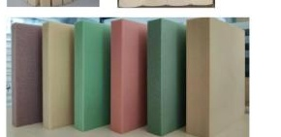
1,000 M STANDARD GRADE
FX400 balances low density with 1,000 m capability
A practical baseline for tools, trenchers and standard buoyancy blocks.
0.40
1,000 m
G/CM³ DENSITY
MAXIMUM WATER DEPTH
>10 MPa
>15 MPa
HYDROSTATIC TEST PRESSURE
COMPRESSIVE STRENGTH
>1,800
≤1%
Standard format 320 × 320 × 100 mm • Custom dimensions available
MPA VOLUME MODULUS
WATER ABSORPTION
SSAEPL | SUBSEA SALES AND ENGINEERING
Source: FX400 technical datasheet, Rev. 2026-07
05

Slide 6
HIGHER-MARGIN 1,000 M GRADE
FX420 adds pressure margin for demanding 1,000 m missions
The recommended standard material for 500 × 500 × 100 mm buoyancy blocks.
FX420
0.42
1,000 m
G/CM³ DENSITY
MAXIMUM WATER DEPTH
Designed for consistent pressure resistance, low water absorption and reliable long-term buoyancy performance.
>14 MPa
>20 MPa
HYDROSTATIC TEST PRESSURE
COMPRESSIVE STRENGTH
STANDARD BLOCK FORMAT
500 × 500 × 100 mm
>2,500
≤1%
Custom dimensions, CNC machining and coatings available on request.
MPA VOLUME MODULUS
WATER ABSORPTION
SSAEPL | SUBSEA SALES AND ENGINEERING
Source: FX420 technical datasheet, Rev. 2026-07
06

Slide 7
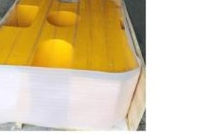
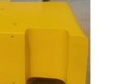
CUSTOMIZATION
Standard blocks become mission-ready modules through machining
Geometry, interfaces and coatings are engineered around the installation.
01
MATERIAL
02
MACHINE
03
PROTECT
Select grade by depth, load and buoyancy target
CNC profiles, cavities and interfaces
Paint, polyurethane or polyurea coating
Result: buoyancy that fits the vehicle, not a vehicle redesigned around the buoyancy.
SSAEPL | SUBSEA SALES AND ENGINEERING
Source: user-provided product overview
07

Slide 8
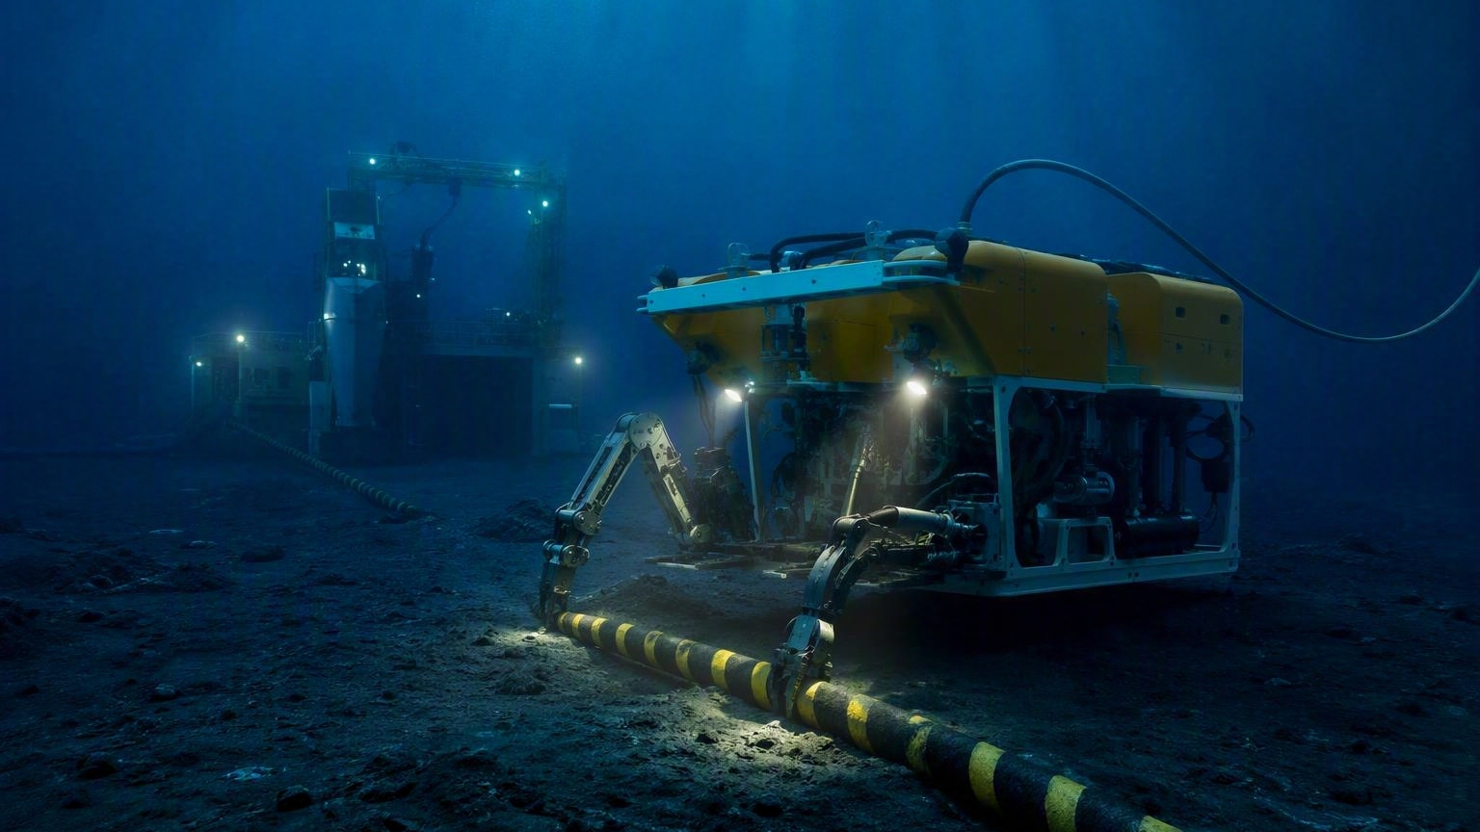
APPLICATIONS
One material platform supports vehicles, cables and subsea infrastructure
ROV / AUV
CABLE SYSTEMS
SUBSEA TOOLS
INFRASTRUCTURE
Vehicle buoyancy and spare-part modules
Cable floats, laying equipment and umbilicals
Trenchers, landers and instrumentation
Pipeline, riser, beacon and mooring buoyancy
SSAEPL | SUBSEA SALES AND ENGINEERING
Applications from user-provided overview; imagery is illustrative
08

Slide 9
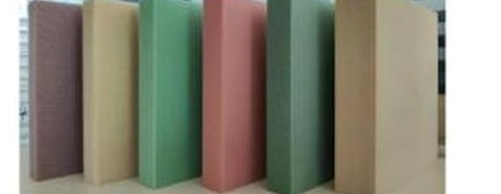
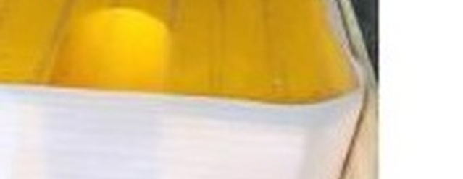
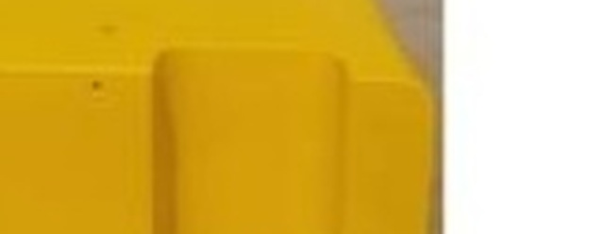
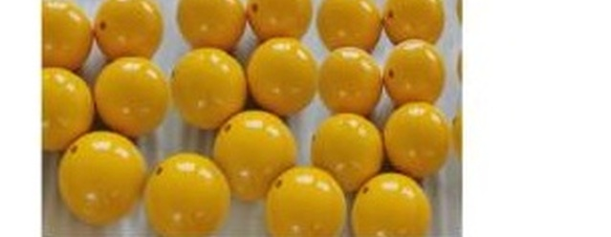
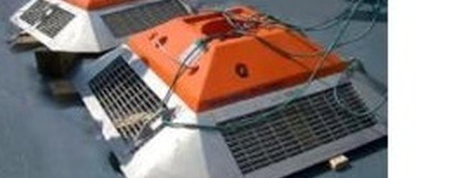
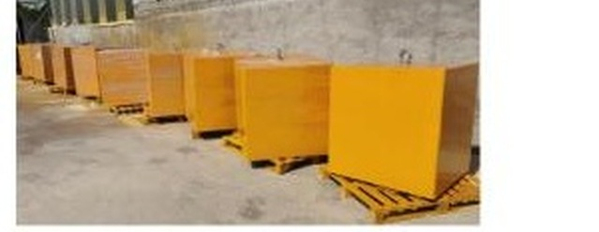
PRODUCT LISTING
Product listing for subsea buoyancy systems
Standard blocks, machined modules, float balls, vehicle buoyancy and cable tooling.
STANDARD BLOCKS
MACHINED MODULES
LARGE MODULES
Stock formats and density grades
CNC cavities, profiles and interfaces
Vehicle and equipment buoyancy
FLOAT BALLS
AUV BUOYANCY
CABLE & TOOLING
Spherical buoyancy for deepwater systems
Hydrodynamic vehicle-specific forms
Cable laying, trenching and infrastructure
SSAEPL | SUBSEA SALES AND ENGINEERING
Images: user-provided product overview; product-only crops
09

Slide 10
PRODUCT SPECIFICATIONS
Representative product specifications
Typical density, dimensions and depth ranges from the supplied product portfolio.
PRODUCT FORM | DENSITY | REPRESENTATIVE DIMENSIONS | DEPTH | TECHNICAL NOTES
Standard blocks | 0.36–0.58 g/cm³ | 320 × 320 × 100 mm 500 × 500 × 100 mm | 300–6,000 m | CNC machinable; custom dimensions
Float balls | 0.42–0.56 g/cm³ | Ø200–Ø350 mm | 1,500–5,000 m | Multiple density/depth combinations
ROV buoyancy | 0.36–0.40 g/cm³ | 125 × 50 × 300 mm 700 × 630 × 10 mm | 250–700 m | Custom vehicle and spare-part forms
AUV buoyancy | 0.36–0.55 g/cm³ | 108 × 40 × 150 mm 300 × 300 × 100 mm | 300–4,500 m | Hydrodynamic machining available
Cable / pipeline floats | 0.40–0.51 g/cm³ | Ø150 × 100 mm Ø500 × 6,000 mm | 700–3,000 m | Segmented or clamp-on configurations
Custom modules | Project-specific | Customized to installation envelope | 300–6,000 m | Polyurea, polyurethane or protective paint
Typical values are for reference only and are not guaranteed specifications. Confirm pressure rating, safety factor, water absorption and coating for the final geometry.
SSAEPL | SUBSEA SALES AND ENGINEERING
Source: user-provided company profile and product overview
10

Slide 11
ENGINEERING SUPPORT
SSAEPL supports the path from load case to delivered module
Bring the mission inputs; leave with a manufacturable buoyancy solution.
01
02
03
04
DEFINE
SELECT
ENGINEER
DELIVER
Depth, buoyancy target, envelope and interfaces
Material grade, safety margin and block format
CNC geometry, inserts, coating and assembly
Manufactured module with agreed inspection data
START WITH THESE FIVE INPUTS
Operating depth
Required net buoyancy
Available envelope
Mechanical interfaces
Coating / environment
SSAEPL | SUBSEA SALES AND ENGINEERING
Engineering inputs derived from attached technical materials
11

Slide 12
SURFACE
Let’s engineer the right
buoyancy system.
1000 m
Share the operating depth, required buoyancy, available geometry and interface constraints.
3000 m
TECHNICAL & COMMERCIAL ENQUIRIES
Subsea Sales and Engineering Pte. Ltd. | SSAEPL
ENQUIRY@SSAEPL.COM
6000 m
MANUFACTURER OF SUBSEA SYNTACTIC-FOAM BUOYANCY SOLUTIONS
Custom module capability is project-specific; final design is subject to engineering review.

